Slide 1
Implementing PILARS
Ensuring Digital Language and Cultural-Heritage Materials Remain Accessible, Usable, and Sustainably Managed Over Time
Preserving digital language and cultural collections
By adopting open standards and clear governance
Sustainable stewardship protects past investments in research and infrastructure
Addressing this problem isn’t just about technology
Notes:
An adaptation of a presentation delivered at the 2025 Annual Symposium of the HASS and Indigenous Research Data Commons.
Preserving digital language and cultural-heritage materials isn’t just a technical exercise—it’s about safeguarding knowledge, identity, and history for future generations. As collections grow and as data becomes increasingly fragmented across institutions, the challenge is no longer simply storing information. It’s ensuring that community-owned knowledge remains accessible, usable, and sustainably managed over time.
At the Language Data Commons of Australia (LDaCA), we’ve been working toward this goal by adopting open standards, building clear governance mechanisms, and designing infrastructure that communities can trust and control. The result of this work is <strong>PILARS</strong>: the Protocols for Implementing Long-Term Archival Repository Services.

Slide 2
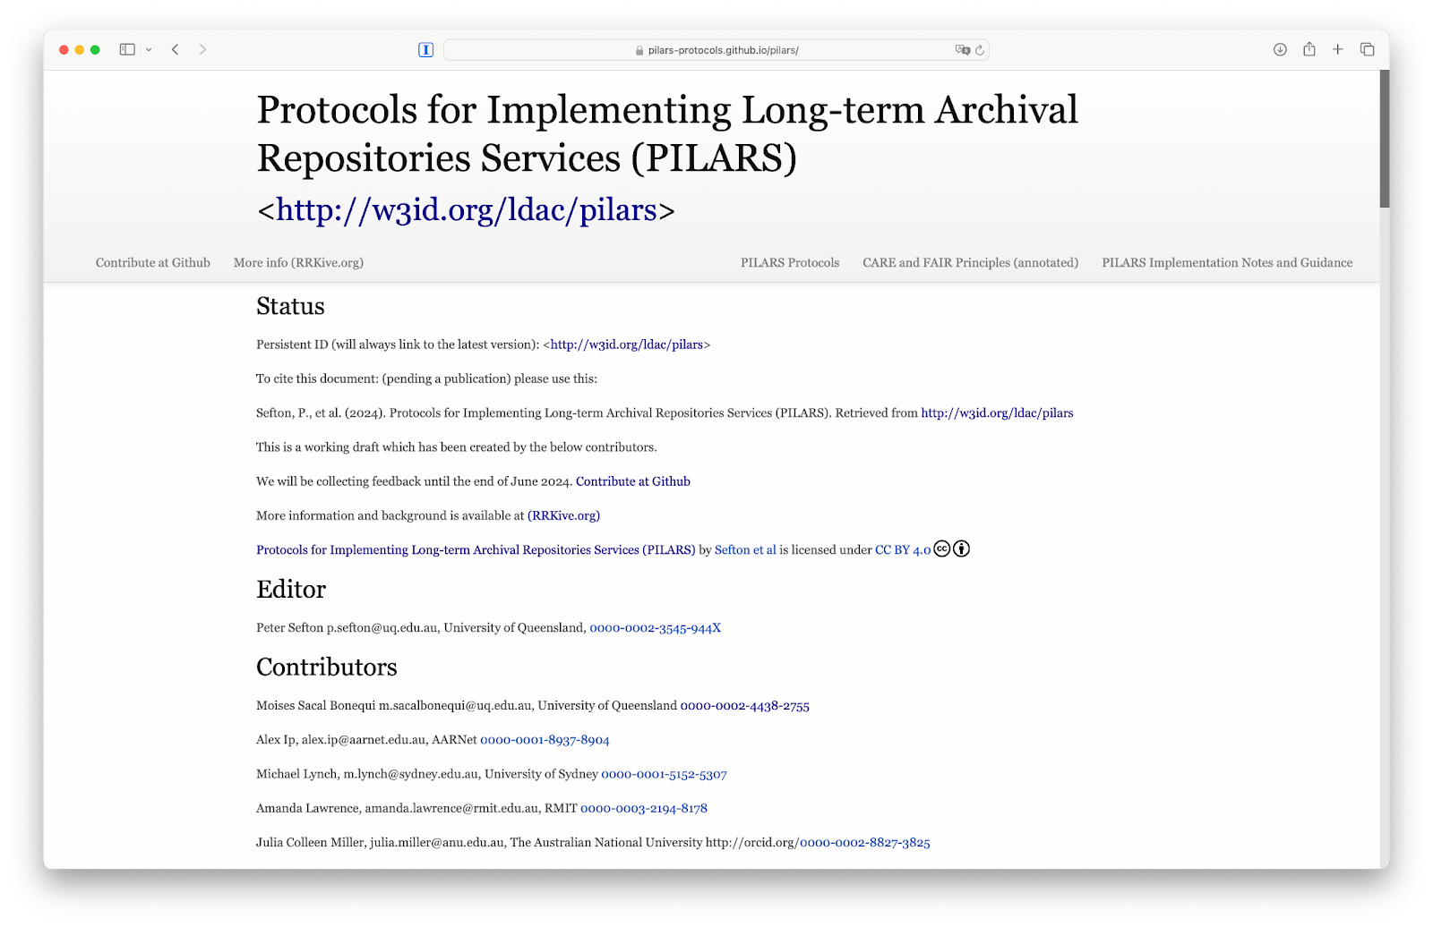
LDaCA Architecture
The LDaCA architecture is implemented using the Protocols for Implementing Long Term Archival-Repository Services (PILARS)
Data is portable and not locked into a particular storage system.
Data can be stored and described in systems based on Open Specifications.
Services such as authorised access interfaces, catalogues and search engines can be built and rebuilt from these data in a storage system using Open Source Software solutions, services and tools.
Notes:
## How are we implementing our work.
We designed the Protocols for Implementing Long-Term archival Repository Services
These are: Designed to work in low-resource environments,
To allow communities to have agency and control over their materials.
And prioritise sustainability, simplicity, standardisation, linked-data description and clear licensing over user interface features

Slide 3
PILARS
A framework of protocols to design sustainable archival systems.
Supports FAIR (Findable, Accessible, Interoperable, Reusable) and CARE (Collective Benefit, Authority to Control, Responsibility, Ethics) principles.
Data Portability
Commodity Storage
Storage Objects
Store documentation within storage root
2. Metadata & Annotation
Each object has descriptive metadata (usage rights, provenance)
Use Linked Data, Represent high level structures
3. Governance
PILARS Goals
Autonomy
Sustainability
Value
Notes:
## Why PILARS?
PILARS is our framework for designing sustainable archival systems—particularly in low-resource environments where communities need agency, autonomy, and long-term reliability.
The protocols are guided by both the FAIR (Findable, Accessible, Interoperable, Reusable) and CARE (Collective Benefit, Authority to Control, Responsibility, Ethics) principles. Together, these ensure that while data remains discoverable and reusable, the rights and authority of communities are respected and embedded in the system itself.
Our goals are simple:
Autonomy: Reduce reliance on closed, proprietary, or opaque storage systems.
Sustainability: Ensure that data remains intact and accessible decades from now.
Value: Maximise the return on investment in digital collections and research infrastructure.

Slide 4
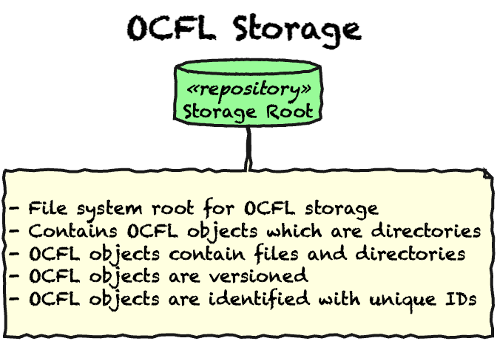
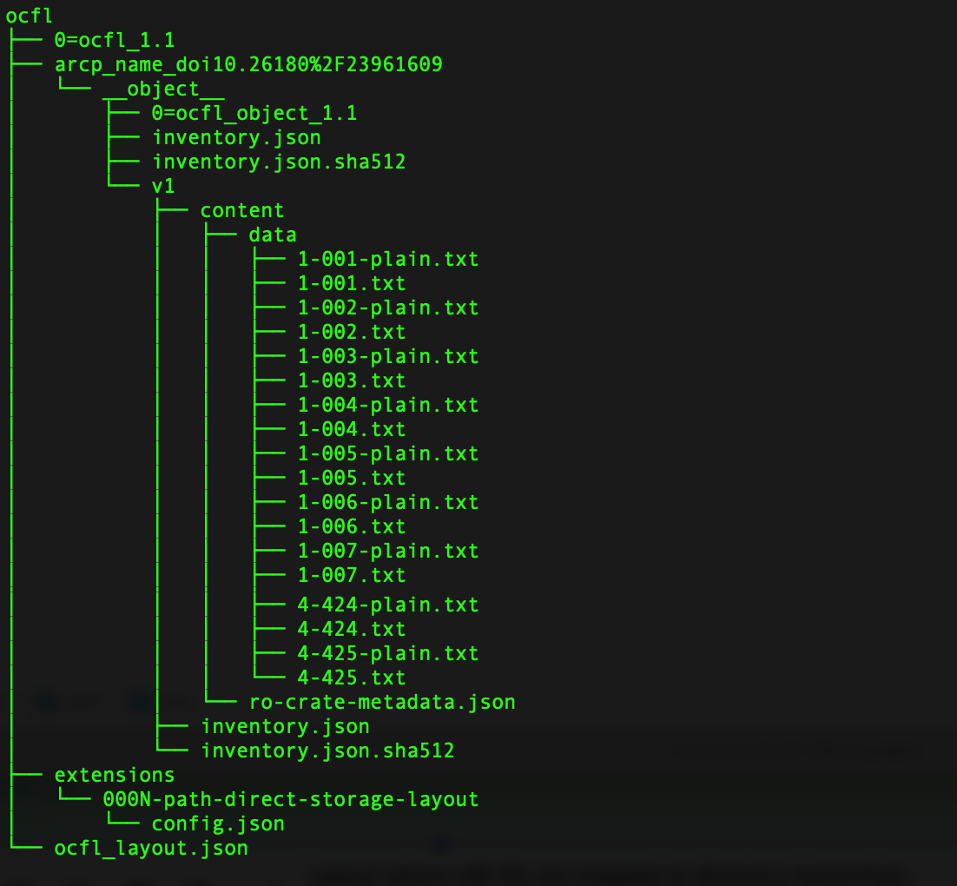
1 - Data is Portable
The Oxford Common File Layout
Notes:
## 1. Data Portability: The Foundation
PILARS insists on storing data in a way that is portable, stable, and independent of any particular platform.
We do this by using:
OCFL (Oxford Common File Layout)
A community standard that ensures digital objects are stored in a transparent, predictable, and platform-independent structure. LDaCA extends OCFL with a storage-layout specification that maps identifiers to directory structures in both filesystems and object storage.

Slide 5
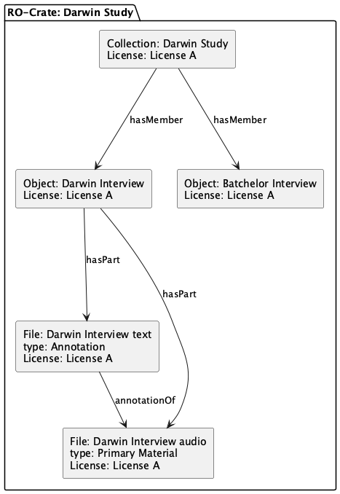
Storage
Storage Objects are deposited in a repository. In LDaCA each storage object is an RO-Crate.
An RO-Crate is a Research Object (or RO) formed of a collection of data (a crate), a special ro-crate-metadata.json file which describes the collection and its license information.
The ro-crate-metadata.json file is a JSON-LD metadata file at the root of an RO-Crate that describes the crate, its contents, and their relationships in a machine-readable way.
Notes:
## RO-Crate
Every storage object we deposit is an RO-Crate—a research object composed of:
The data files themselves
A JSON-LD metadata file (ro-crate-metadata.json) that describes the content, its provenance, and licensing
An RO-Crate can represent a collection, an interview, a series, or any structured set of materials. Each file is described, linked, and licensed in machine-readable form so that tools, portals, and search engines can reconstruct meaning without custom logic.

Slide 6
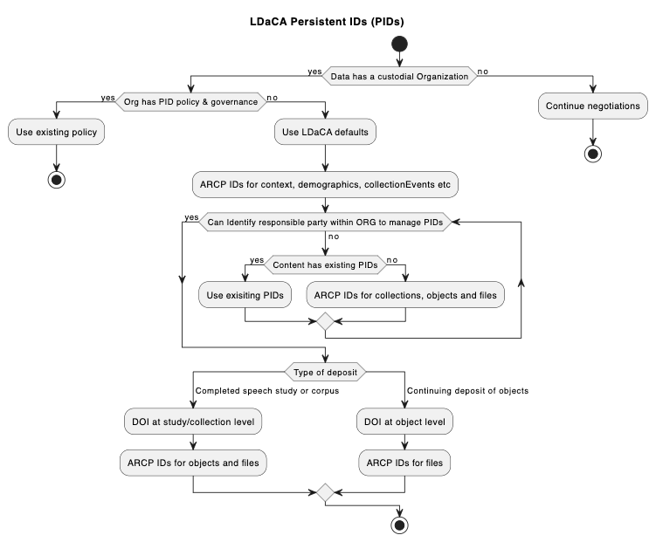
Persistant IDs
OCFL is laid out as URI IDs and mapped to directory hierarchies.
Notes:
## Persistent Identifiers
While institutions may not always have PID systems in place, LDaCA supports temporary identifiers like ARCP until more formal identifiers (such as DOIs) are assigned. This means repositories can begin storing and organising data immediately, without waiting for institution-wide decisions.

Slide 7
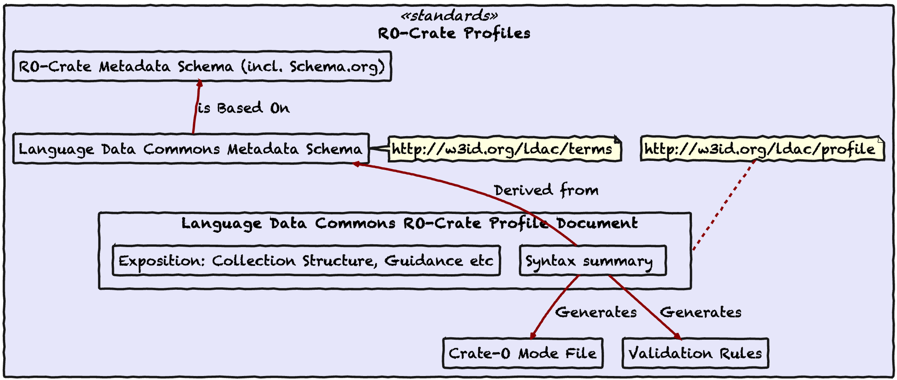
2 Data is annotated
Notes:
## 2. Metadata & Annotation: Making Data Understandable
Metadata is where collections become meaningful. For LDaCA, metadata runs across several layers:
<strong>RO-Crate Metadata Schema</strong>, built on Schema.org
<strong>LDaCA Metadata Schema</strong>, an extension for language-specific concepts
<strong>LDaCA RO-Crate Profile</strong>, a document that explains how schemas are applied in practice, including both human-readable guidance and machine-readable constraints
<strong>Validation rules</strong> and <strong>Crate-O Mode Files</strong> generated from the profile to ensure every dataset meets requirements

Slide 8
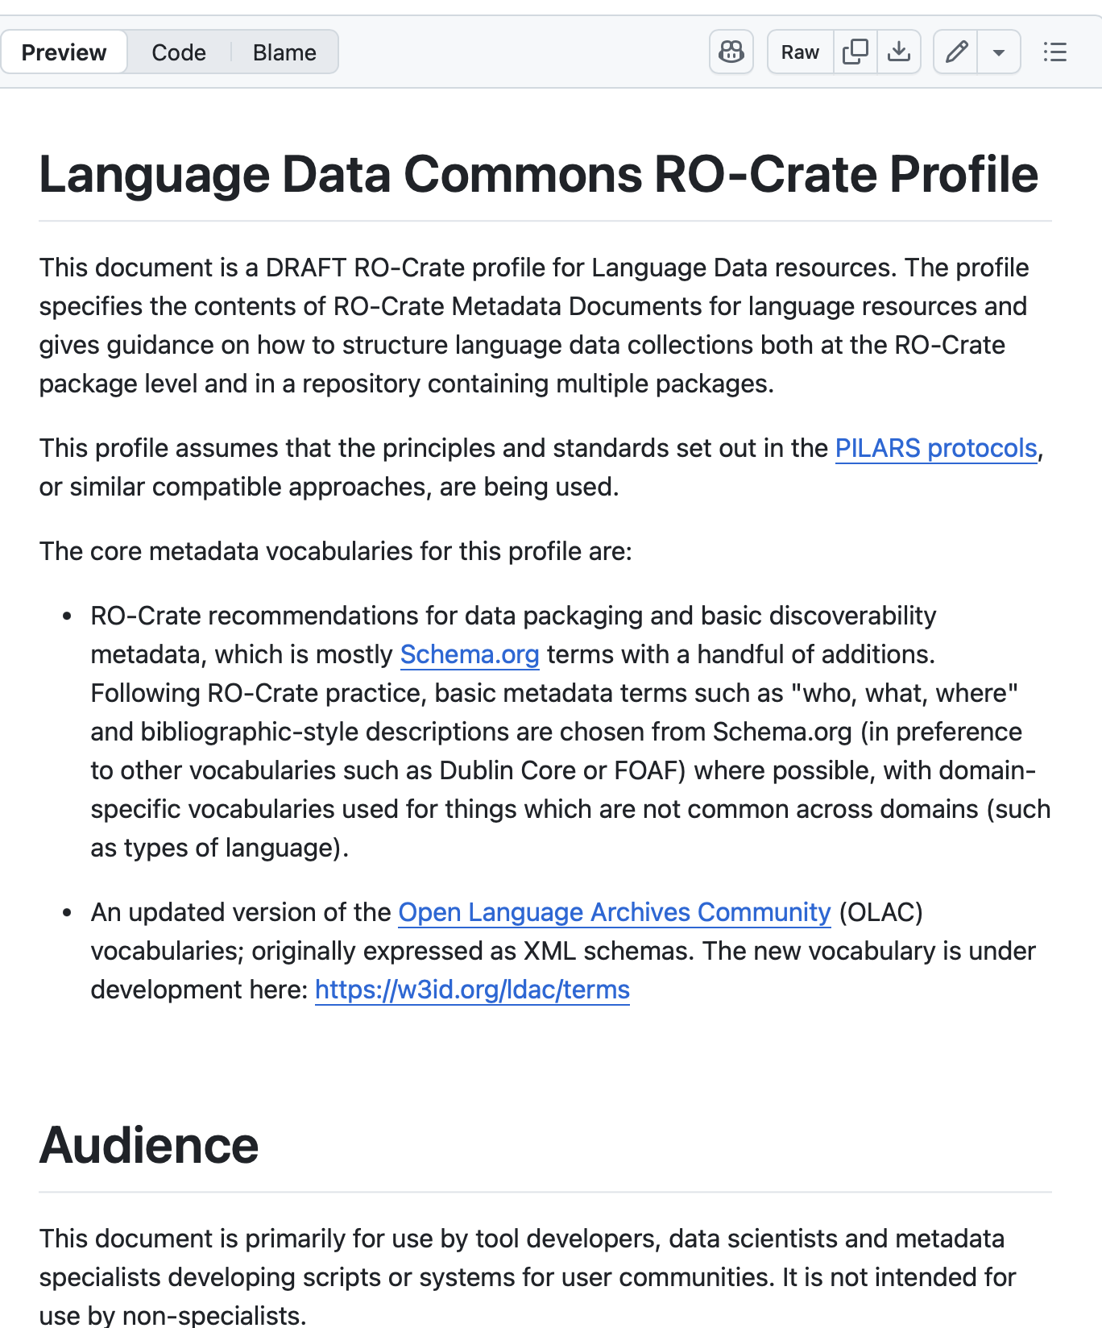
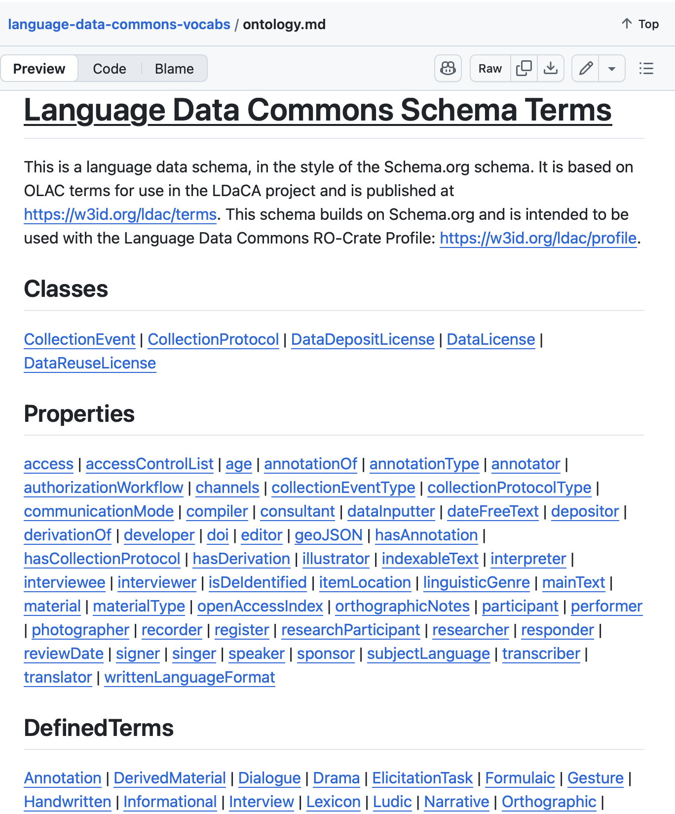
Metadata Schemas
Notes:
These are our schemas available to the public.
<http://w3id.org/ldac/profile>
<http://w3id.org/ldac/terms>

Slide 9
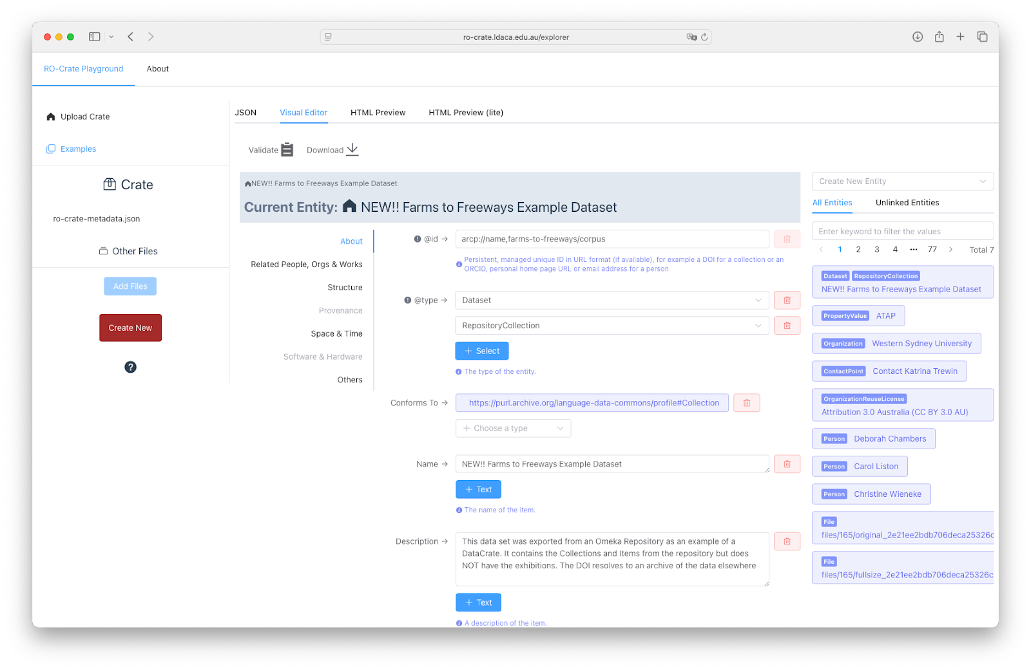
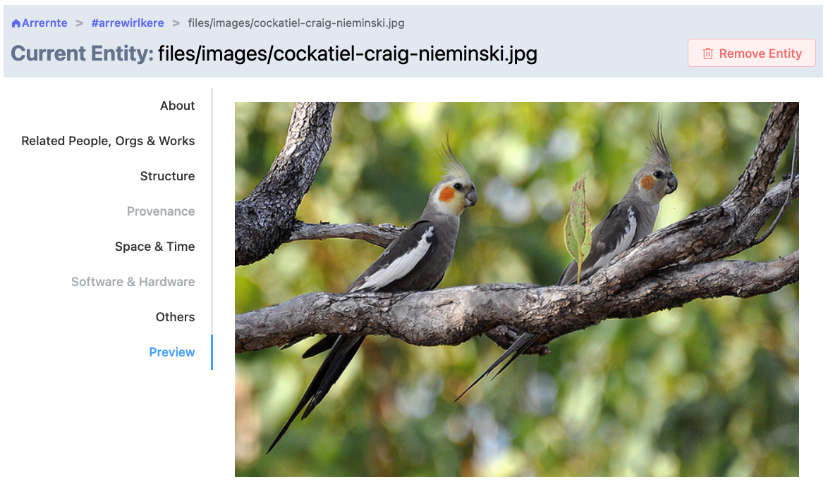
Annotate
Notes:
## Tools for creating metadata
To support researchers and communities, we created Crate-O, a Vue.js-based tool that:
Provides guided metadata creation
Integrates with services like ROR for organisation lookup
Accepts spreadsheets and converts them into RO-Crates
Allows batch upload of metadata
Can run locally, in portals, or as GitHub Pages
Most of the real work of metadata creation still happens in spreadsheets—but Crate-O helps turn that into structured, validated metadata.

Slide 10
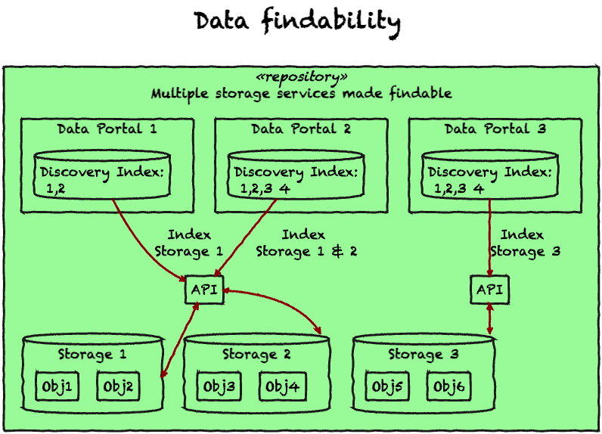
Index
Portals can be then indexed from the storage to make them findable
Notes:
## Findability: From Storage to Search
Once data is stored and described, it must be discoverable.
LDaCA uses:
PILARS-compliant storage
An API layer that exposes data consistently
Indexing pipelines to make data searchable across distributed services
Tools for building portals on demand—automated via Terraform—that communities can manage themselves

Slide 11
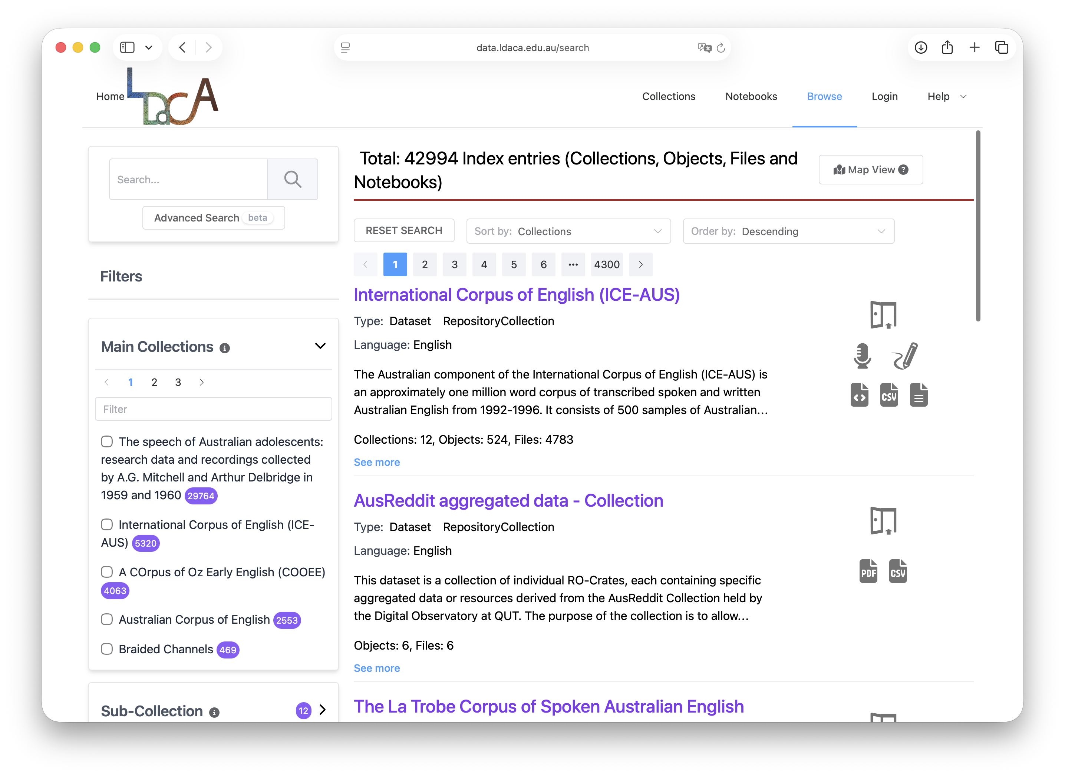
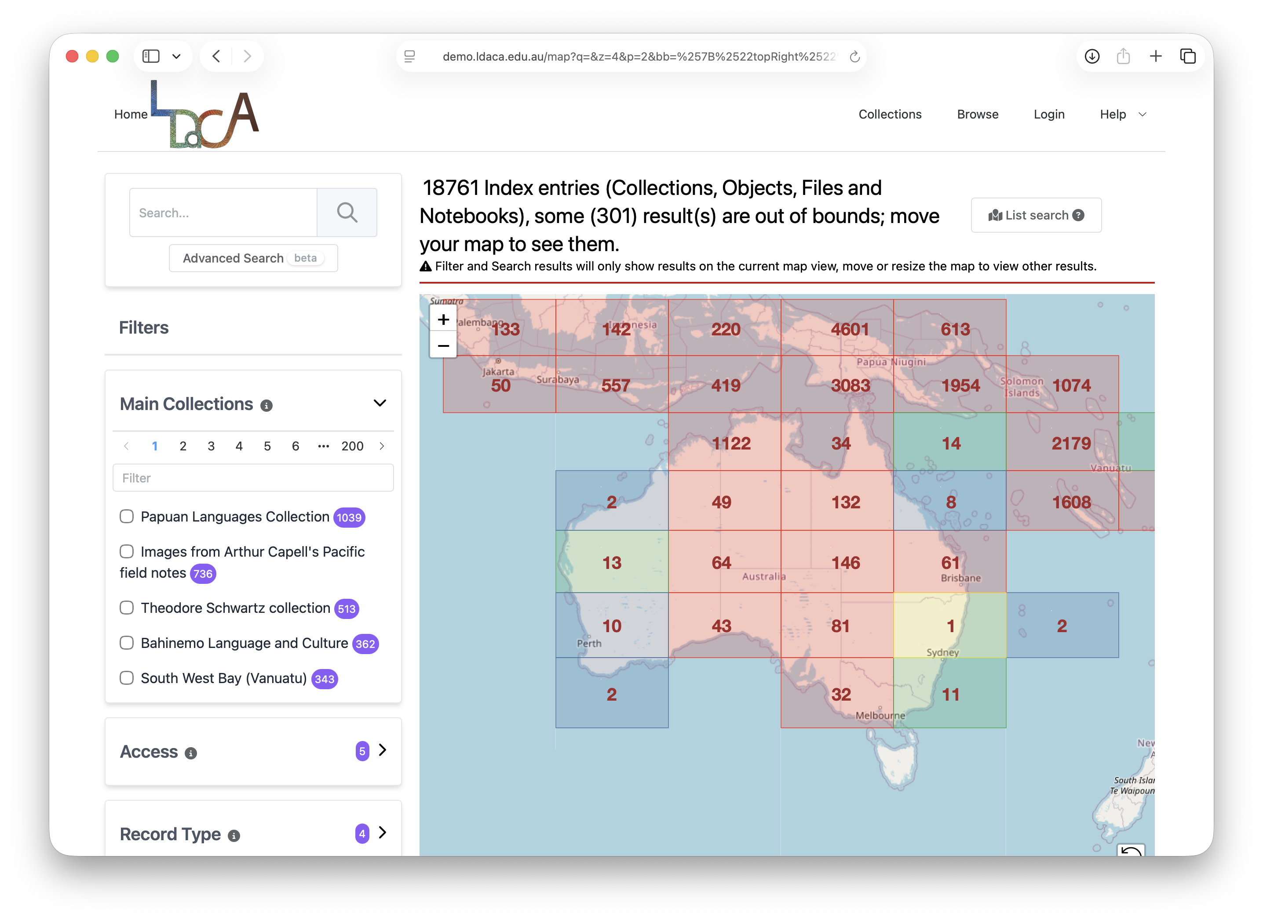
Portal(s)
Notes:
Our main portal aggregates language datasets curated by LDaCA, while community instances provide tailored environments for managing and exploring their own collections.

Slide 12
Access Control
A distributed access control system that leverages federated authenication (AAF) independently of authorization services.
Key features:
License-based access control
Enforcement points
Interoperable protocols
Motivation
FAIR data principles require not just openness but controlled access in many contexts.
Traditional centralized access control solutions struggle with scalability, sustainability, cross-institutional trust, privacy, and fine-grained permissions.
Architecture & Workflow
User requests access
Enforcement point at repository
Repository polls authorization server if necessary
Decision point at authorization server
Audit & logging
Benefits | Challenges & Considerations
Scalability across organizations | Ensuring trust among domains
Fine-grained, dynamic access control | Performance overhead of distributed checks
Compliance with FAIR’s “Accessible” principle | Handling license revocation, privacy, and interoperability
Notes:
## Access Control: Distributed, License-Based, and Interoperable
LDaCA has implemented a distributed access-control system that separates:
Authentication (who you are)
Authorization (what you’re allowed to access)
We use federated identity systems like CILogon and eduGAIN, and partner with platforms like CADRE and REMS to manage entitlement workflows.
Instead of role-based permissions locked inside a single system, we use license-based access control. Your entitlements—granted through a governance process—travel with you, allowing enforcement points at each data repository to make decisions consistently and automatically.
This approach:
Scales across institutions
Supports sensitive or community-restricted data
Ensures transparent auditing and revocation
Respects the governance requirements of language communities

Slide 13
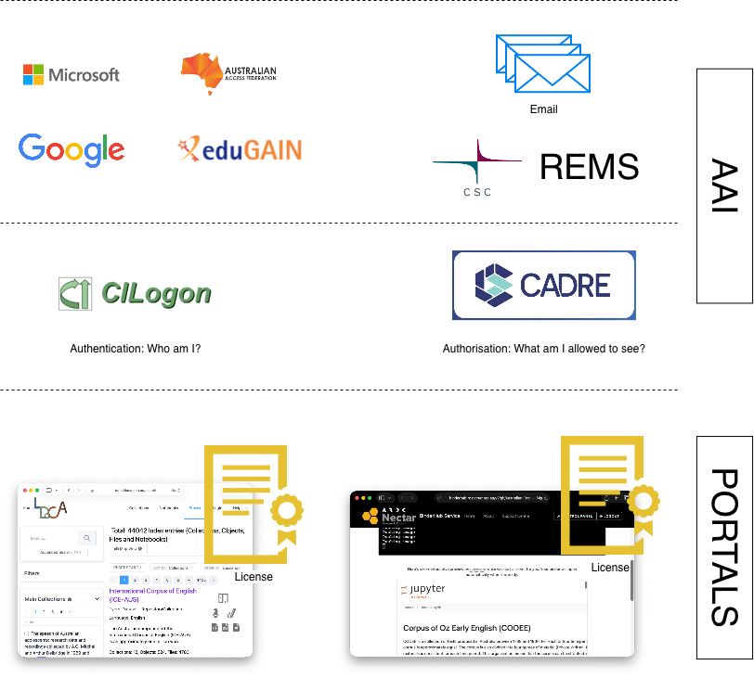
Access Control
Notes:
The above diagram represents our Authorisation and Authentication Infrastructure.
With <strong>CILogon</strong> - an Identity and access management platform enables researchers to use their existing credentials
Supported by AAF we are using <strong>EduGAIN</strong> - The eduGAIN interfederation service connects identity federations around the world
<strong>CADRE</strong> - for authorization – CADRE Coordinated Access for Data, Researchers and Environments is a shared platform for safely handling requests to access sensitive data, addressing governance, creation, management and sharing of data for research. We have a service agreement with CADRE to provide access controls. CADRE uses REMS at the backend for resource management – Resource Entitlement Management System is a tool for managing access rights to resources, such as research datasets.
These means – with this licensed based authorization mechanisms - You are licensed to access sensitive materials

Slide 14
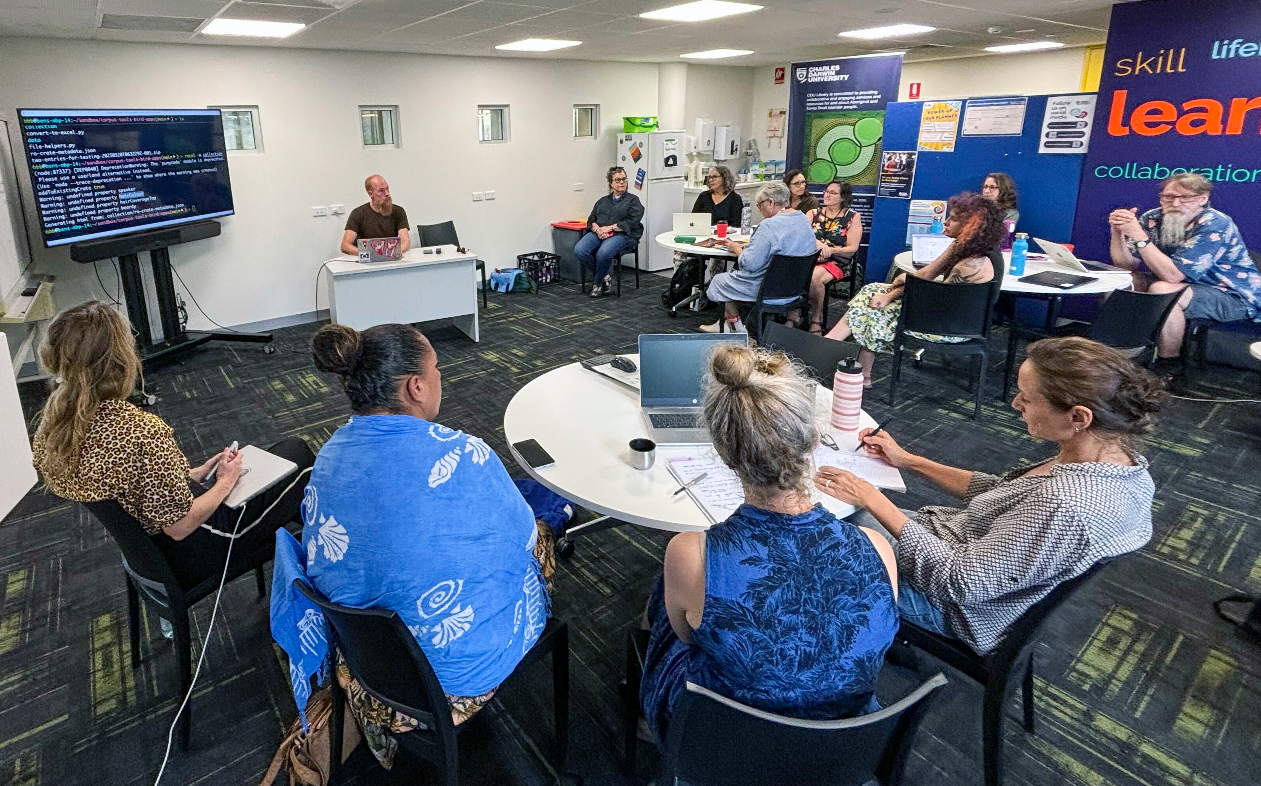
Key Learnings and Future Plans
Notes:
<center>Photo of LDaCA workshop in Darwin at Charles Darwin University campus</center>

Slide 15
Beyond project websites; sustainable dashboards
The focus is on delivery
Decisions are made for speed and appearance,
Code, data, and dependencies often become conflated .
When the developer moves on, knowledge and maintenance capacity disappear.
What began as a useful tool can become a fragile, unmaintained system
The focus shifts from quick delivery to long-term value and maintainability.
Systems are built with open standards,
Data and code are portable and separate
Maintenance is part of the design
The result is a system that endures beyond individual projects and people
Notes:
## Building Sustainable Systems, Not Just Dashboards
One of our biggest learnings is this: <strong>Dashboards and portals are easy to build, but hard to maintain. </strong>
Too often:
- Design choices prioritise speed over long-term care
- Knowledge is tied to individual developers
- Data, code, and dependencies get tightly coupled
- Tools become fragile and unmaintained once the project ends
We want to change that pattern.
By building with open standards, separating data from code, and treating maintenance as an expected part of system design, we ensure tools outlive projects—and people.

Slide 16
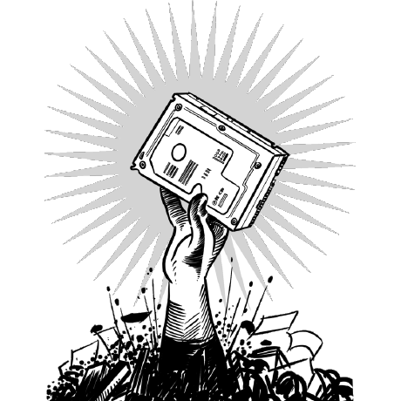
TODO
Fix bugs maintain our tools UX improvements
Design and implement complete Workflow for Interactive Deposits
Add more language data collections
Add more analytical notebooks and tools
https://ocfl.io/1.1.0/spec/
Notes:
What’s Next
There is still work ahead:
- Fixing bugs and improving the user experience
- Completing workflows for interactive deposits
- Expanding language data collections
- Adding analytical notebooks and tools
- Sharing the LDaCA approach across disciplines
- Strengthening governance frameworks
But the foundation—the PILARS protocols—gives us a sustainable, community-centered way forward.

Slide 17
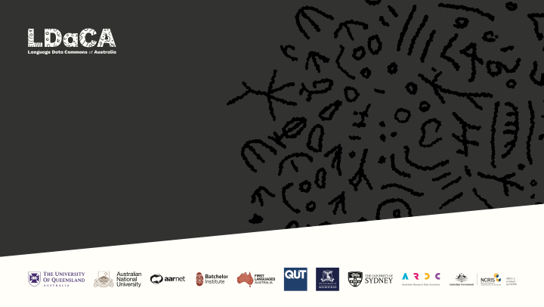
Implementing PILARS
Moises Sacal Bonequi
Notes:
Acknowledging the iconography within the Language Data Commons of Australia (LDaCA) logo, designed by Dylan Sarra.
The design draws inspiration from the Burnett River Petroglyphs, and we recognise the Gureng Gureng communal knowledges that inhere within these symbols.
Much like the Indigenous language and cultural data dispersed across many institutions and archives which LDaCA engages with regularly, the Burnett River Petroglyphs themselves were jackhammered and scattered across Queensland in 1972 — this story lives on today through people… And it is ‘people’ who are central to the data which LDaCA intersects with.

